Slide 1














Sales Business Intelligence Dashboard
P R E S E N T A T I O N 2 0 2 6
Student Name
Dhanalakshmi Kalyani
Elakia
Student Email
dhanalakshminadar04@g mail.com kkaallyyaannii123@gmail. com eellaakkiiaa123@gmail.co
Guide
Akshay

Slide 2

OUTLINE
Abstract of the Project
Problem Statement
Proposed Solution
System Architecture
Live Demo of the Project
Project Demo Screenshots
Conclusion
Future Scope

Slide 3
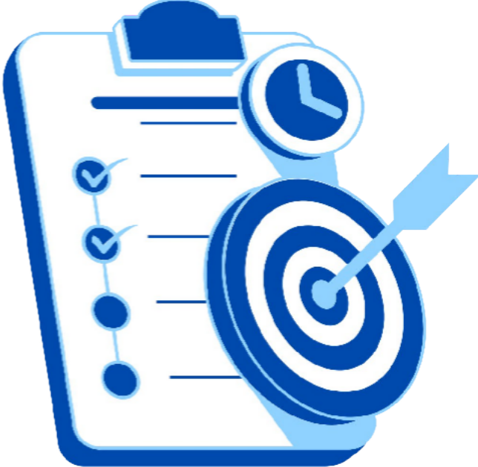
Abstract
Cleaned messy retail data into meaningful insights.
Handled duplicates and missing values for accuracy.
Used Excel and Power BI, for analysis.
Enabled natural language data exploration.
Improved decision-making and performance tracking.

Slide 4

Problem Statement
Data is often inconsistent, missing, or duplicated.
Poor data quality leads to inaccurate business insights.
Manual data processing is slow and error- prone.
Hidden valuable customer and product insights.

Slide 5

Proposed Solution
Combines Excel and Power BI for interactive visuals.
Replaces static reports with dynamic insights. Enables faster, real-time business analysis

Slide 6


System Architecture
Data Input
Raw Sales Datasets from Kaggle
Analysis
Clean and model data using Power BI
Dashboard
Dynamic dashboard showing sales, insights, KPI’s and performance trends
Results
Generated dashboards, KPI reports, and sales performance insights

Slide 7





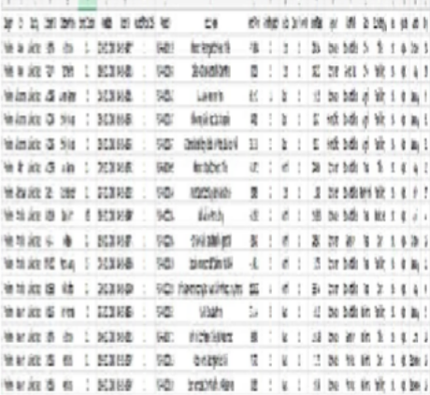
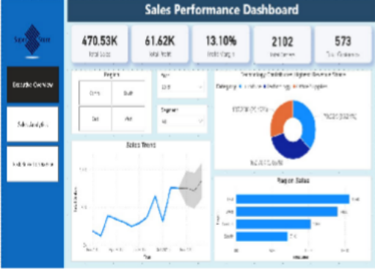
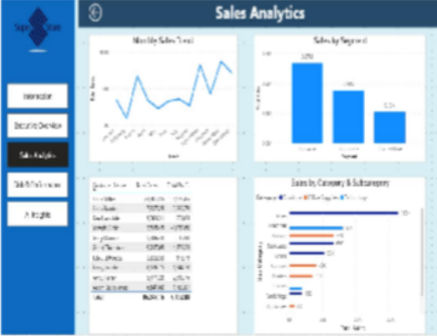
Live Demo of Project
Here’s the list of some demo of the projects -
Demo 1
This is dummy conten
t for the heading demo 1
Demo 2
This is dummy content for the heading demo 2
Demo 3
This is dummy content for the heading demo 3

Slide 8
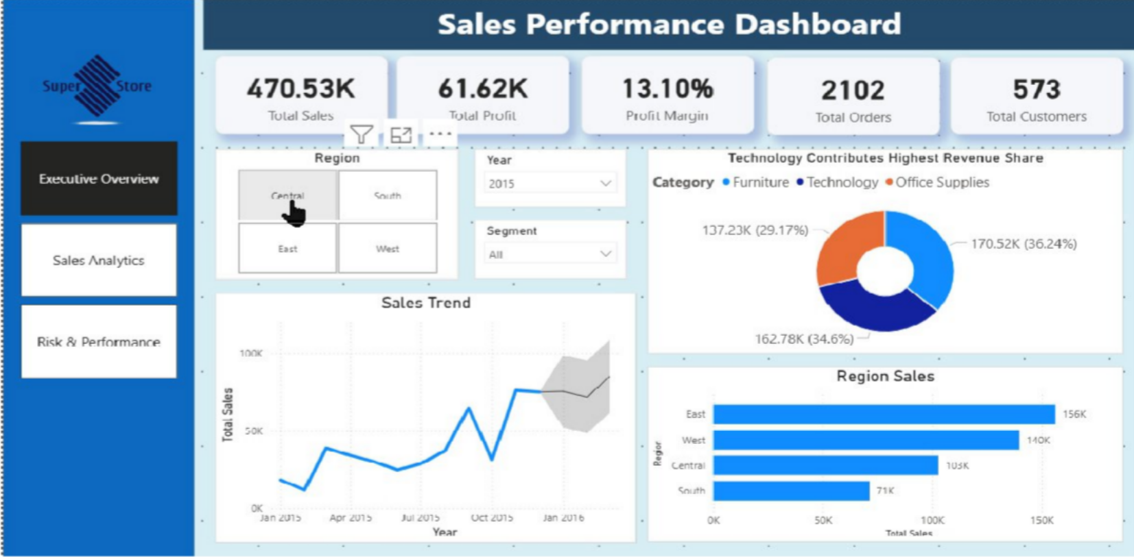
Project Demo Screenshots

Slide 9

Conclusion
Successfully collected, cleaned, and analyzed the dataset to generate meaningful insights.
Created interactive dashboards to visualize important trends and performance indicators.
Improved understanding of business performance through clear and organized visualizations.
Transformed raw data into useful information for better decision-making and analysis.
Demonstrated the effectiveness of data analytics and visualization in supporting strategic planning.

Slide 10

Future Scope
AI-based analytics can be integrated in the future to provide smarter and automated insights.
Predictive analysis can be added to forecast trends, sales, or performance more accurately.
Real-time data integration can improve monitoring and decision-making efficiency.
Advanced interactive dashboards and automation features can enhance user experience.
The project can be expanded with machine learning models for better recommendations and business planning.

Slide 11

Reference:
GitHub Link : https://github.com/mattdelaune/PowerBI_Health care_Dashboard/blob/master/Hospital%20Inight s%20Dashboard.pbix
YouTube Link : https://www.youtube.com/results?search_query
=power+bi+healthcare+dashboard+tutorial
Research Paper Link: https://journal.ijresm.com/index.php/ijresm/articl e/view/2670?utm_source=chatgpt.com

Slide 12
Thank You

